Slide 1

Potential for Bio-inspired Adaptable Design in Structural Engineering
Diwakar V. Singh
Dr. Lauren Stewart
School of Civil and Environmental Engineering
June 20th, 2019

Slide 2
Outline
Motivation and Problem Statement
Multi-disciplinary Paradigm Inspiration
Proposed Framework
Implementation of Algorithm on Case Study Structure
Preliminary Results
Summary of the research
Future Scope of Work

Slide 3
Motivation and Problem Statement (1)
Over years the design of structures advanced with the availability of historical data and improvement of probabilistic methods.
In these structural engineering design approaches, the initial problem constraints are governed by past influences.
For example, earthquake-resilient structures are designed for loads based on historical ground motion data and wind loads are determined from past measurements of gusts.
As climate change and other man-made events rapidly alter our environment, this work seeks to explore a new paradigm in which past influences are removed.

Slide 4
Motivation and Problem Statement (2)
The removal of the predetermined loading conditions will yield a structure that is not specifically designed for given hazards, but adaptable for any environment.
The integration of robotics into structural engineering is proposed by replacing structural elements with decentralized robotic agents.
These decentralized robotic agents are designed to respond to local stimuli such that the global structure remains stable under any environment perturbation

Slide 5
Multi-disciplinary Paradigm Inspiration (1)
Biological Systems:
In the natural world ants, termites and other animals use instinctual, localized behavior to construct structures such as rafts, bridges and dens.
The animals investigated often behave in a de-centralized manner
A local perspective of their involvement of the structure being created
Unaware of their role in the global system and the solution being formed.

Slide 6
Multi-disciplinary Paradigm Inspiration (2)
2. Computer Science and Artificial Intelligence:
The study of the natural environment and the creation of its computational counterparts have been researched and explored.
The de-centralized crowd behavior has been recreated to some extent in physical robotic form with swarm intelligence.

Slide 7
Multi-disciplinary Paradigm Inspiration (3)
3. Engineering Actuators and Control System:
Ongoing research with intelligent agents (IA) in the form of electrohydraulic or electromechanical actuators with controllers.
4. Hazards Engineering:
The electro-hydraulic and/or electro-mechanical agents have been implemented as active control systems for the hazard protection of structures
Notes:
An IA is an autonomous entity that observes through sensors and acts upon an environment using actuators
Active Tuned Mass Damper (ATMD) system to actively control vibrations in structures.

Slide 8
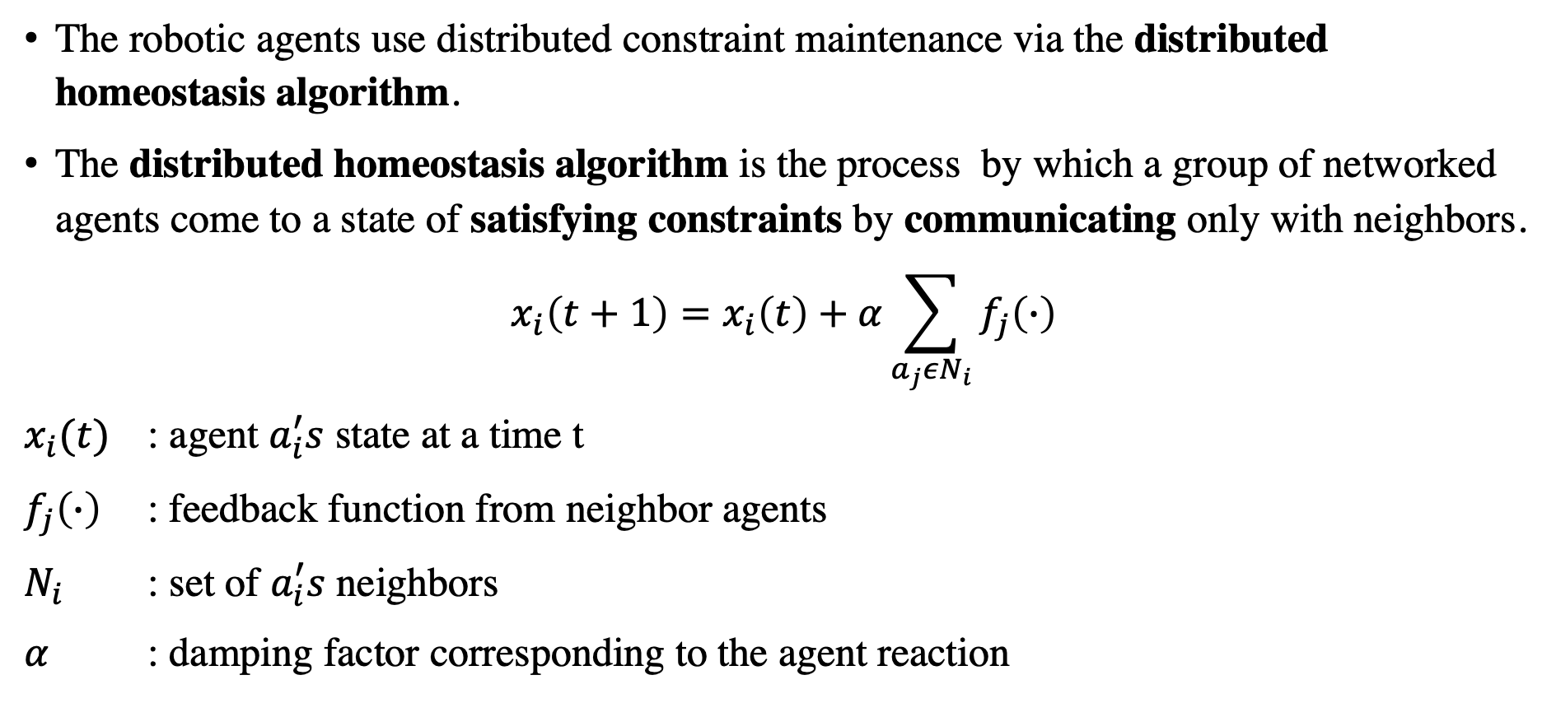
Methods
The robotic agents use distributed constraint maintenance via the distributed homeostasis algorithm.
The distributed homeostasis algorithm is the process by which a group of networked agents come to a state of satisfying constraints by communicating only with neighbors.
$$x_{i}\left(t+1\right)=x_{i}\left(t\right)+α\sum_{a_{j}εN_{i}}{f_{j}\left(∙\right)}$$
$x_{i}(t)$ : agent $a_{i}^{′}s$ state at a time t
$f_{j}\left(∙\right)$ : feedback function from neighbor agents
$N_{i}$ : set of $a_{i}^{′}s$ neighbors
$α$ : damping factor corresponding to the agent reaction

Slide 9
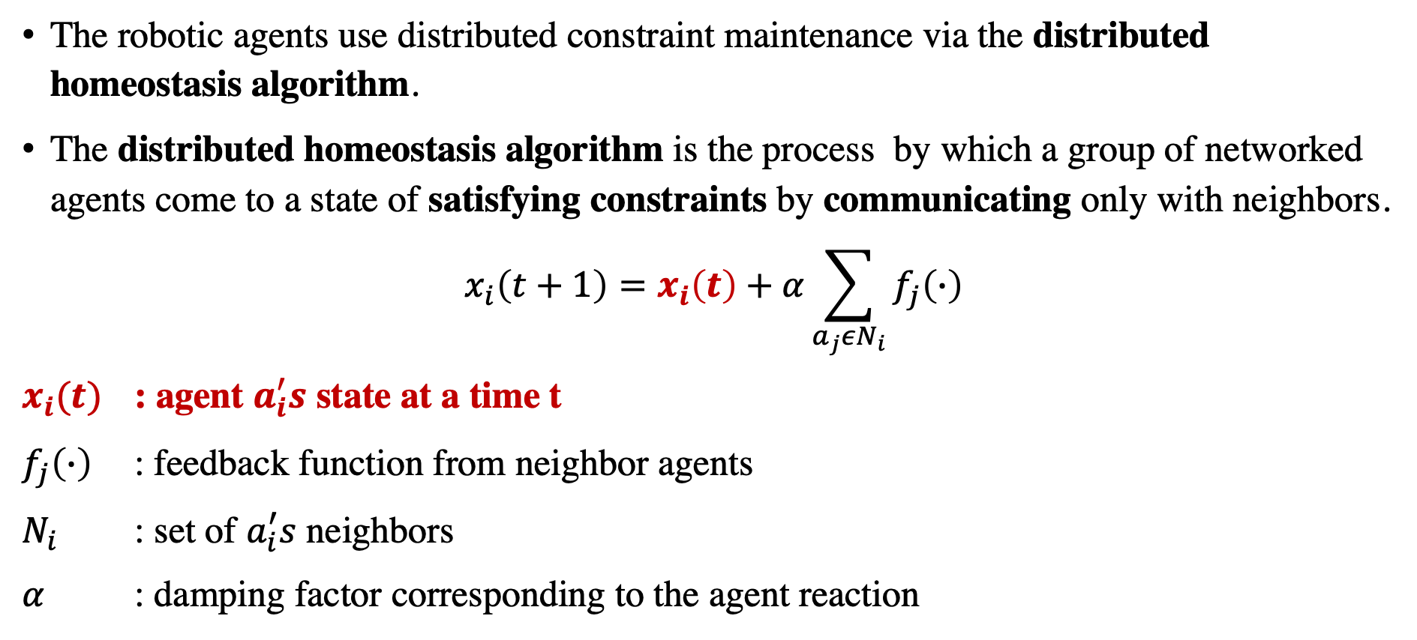
Methods
The robotic agents use distributed constraint maintenance via the distributed homeostasis algorithm.
The distributed homeostasis algorithm is the process by which a group of networked agents come to a state of satisfying constraints by communicating only with neighbors.
$$x_{i}\left(t+1\right)=x_{i}\left(t\right)+α\sum_{a_{j}εN_{i}}{f_{j}\left(∙\right)}$$
$x_{i}(t)$ : agent $a_{i}^{′}s$ state at a time t
$f_{j}\left(∙\right)$ : feedback function from neighbor agents
$N_{i}$ : set of $a_{i}^{′}s$ neighbors
$α$ : damping factor corresponding to the agent reaction

Slide 10
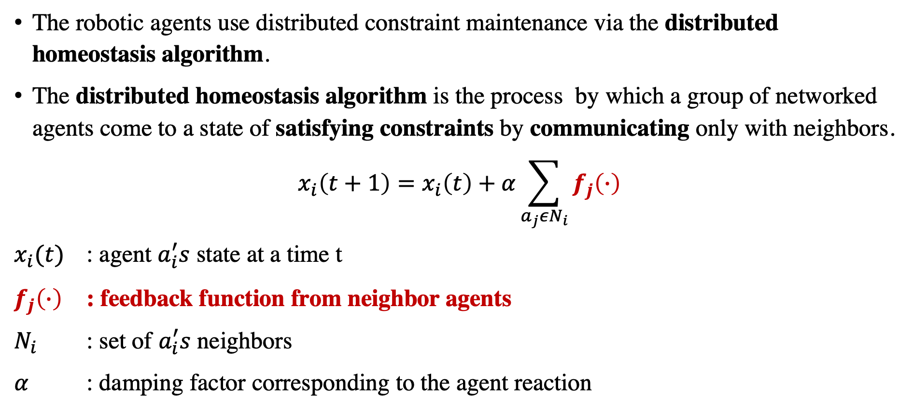
Methods
The robotic agents use distributed constraint maintenance via the distributed homeostasis algorithm.
The distributed homeostasis algorithm is the process by which a group of networked agents come to a state of satisfying constraints by communicating only with neighbors.
$$x_{i}\left(t+1\right)=x_{i}\left(t\right)+α\sum_{a_{j}εN_{i}}{f_{j}\left(∙\right)}$$
$x_{i}(t)$ : agent $a_{i}^{′}s$ state at a time t
$f_{j}\left(∙\right)$ : feedback function from neighbor agents
$N_{i}$ : set of $a_{i}^{′}s$ neighbors
$α$ : damping factor corresponding to the agent reaction

Slide 11
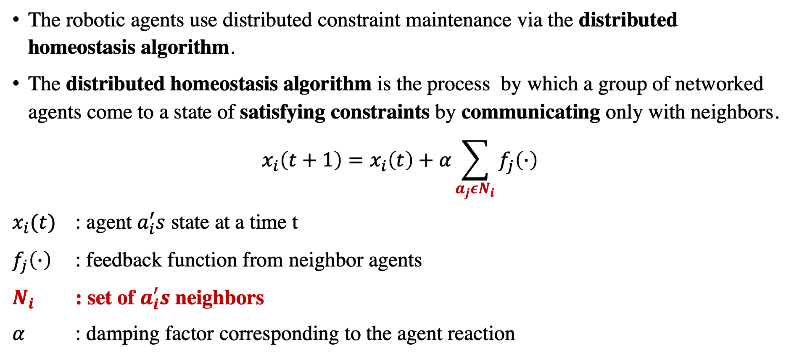
Methods
The robotic agents use distributed constraint maintenance via the distributed homeostasis algorithm.
The distributed homeostasis algorithm is the process by which a group of networked agents come to a state of satisfying constraints by communicating only with neighbors.
$$x_{i}\left(t+1\right)=x_{i}\left(t\right)+α\sum_{a_{j}εN_{i}}{f_{j}\left(∙\right)}$$
$x_{i}(t)$ : agent $a_{i}^{′}s$ state at a time t
$f_{j}\left(∙\right)$ : feedback function from neighbor agents
$N_{i}$ : set of $a_{i}^{′}s$ neighbors
$α$ : damping factor corresponding to the agent reaction

Slide 12
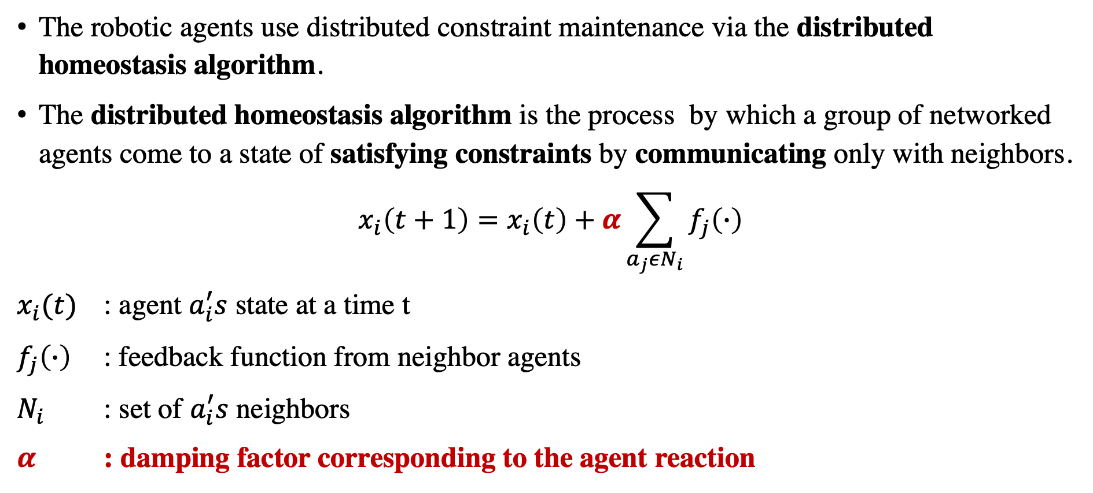
Methods
The robotic agents use distributed constraint maintenance via the distributed homeostasis algorithm.
The distributed homeostasis algorithm is the process by which a group of networked agents come to a state of satisfying constraints by communicating only with neighbors.
$$x_{i}\left(t+1\right)=x_{i}\left(t\right)+α\sum_{a_{j}εN_{i}}{f_{j}\left(∙\right)}$$
$x_{i}(t)$ : agent $a_{i}^{′}s$ state at a time t
$f_{j}\left(∙\right)$ : feedback function from neighbor agents
$N_{i}$ : set of $a_{i}^{′}s$ neighbors
$α$ : damping factor corresponding to the agent reaction

Slide 13
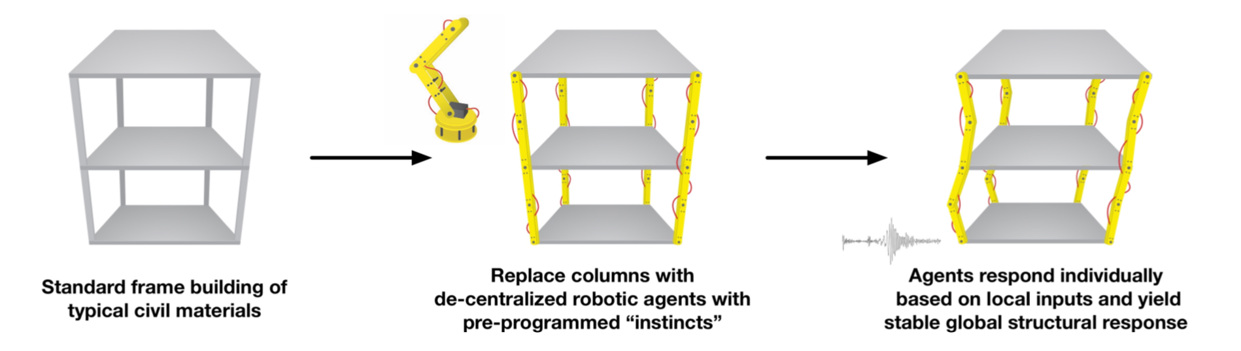
Case Study (1)
A two-story building structure in which the structural column elements are replaced with robotic column agents.
The case study structure contrasts with the passive and active control systems historically used with the control agents.

Slide 14
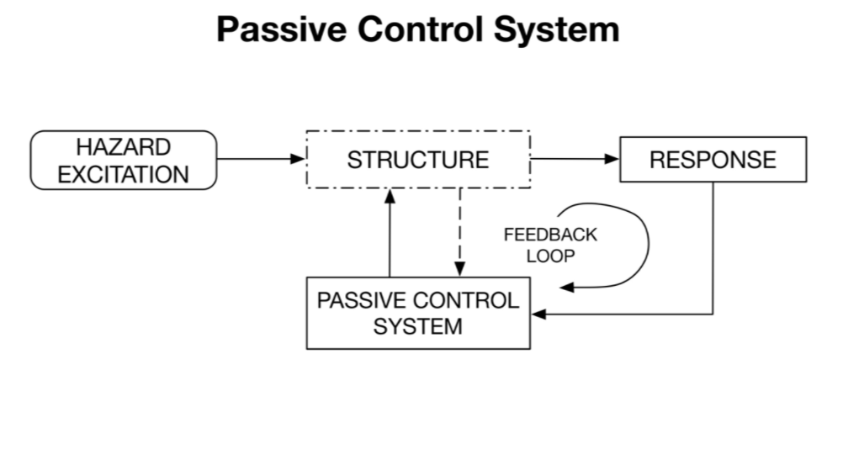
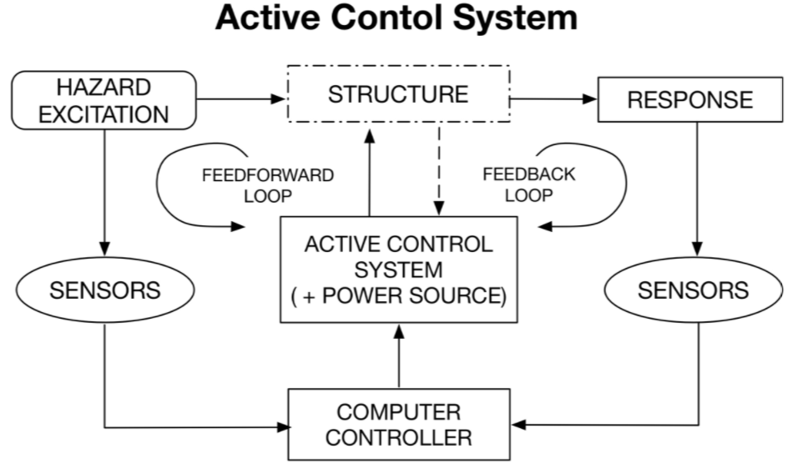
Passive and Active Control System

Slide 15
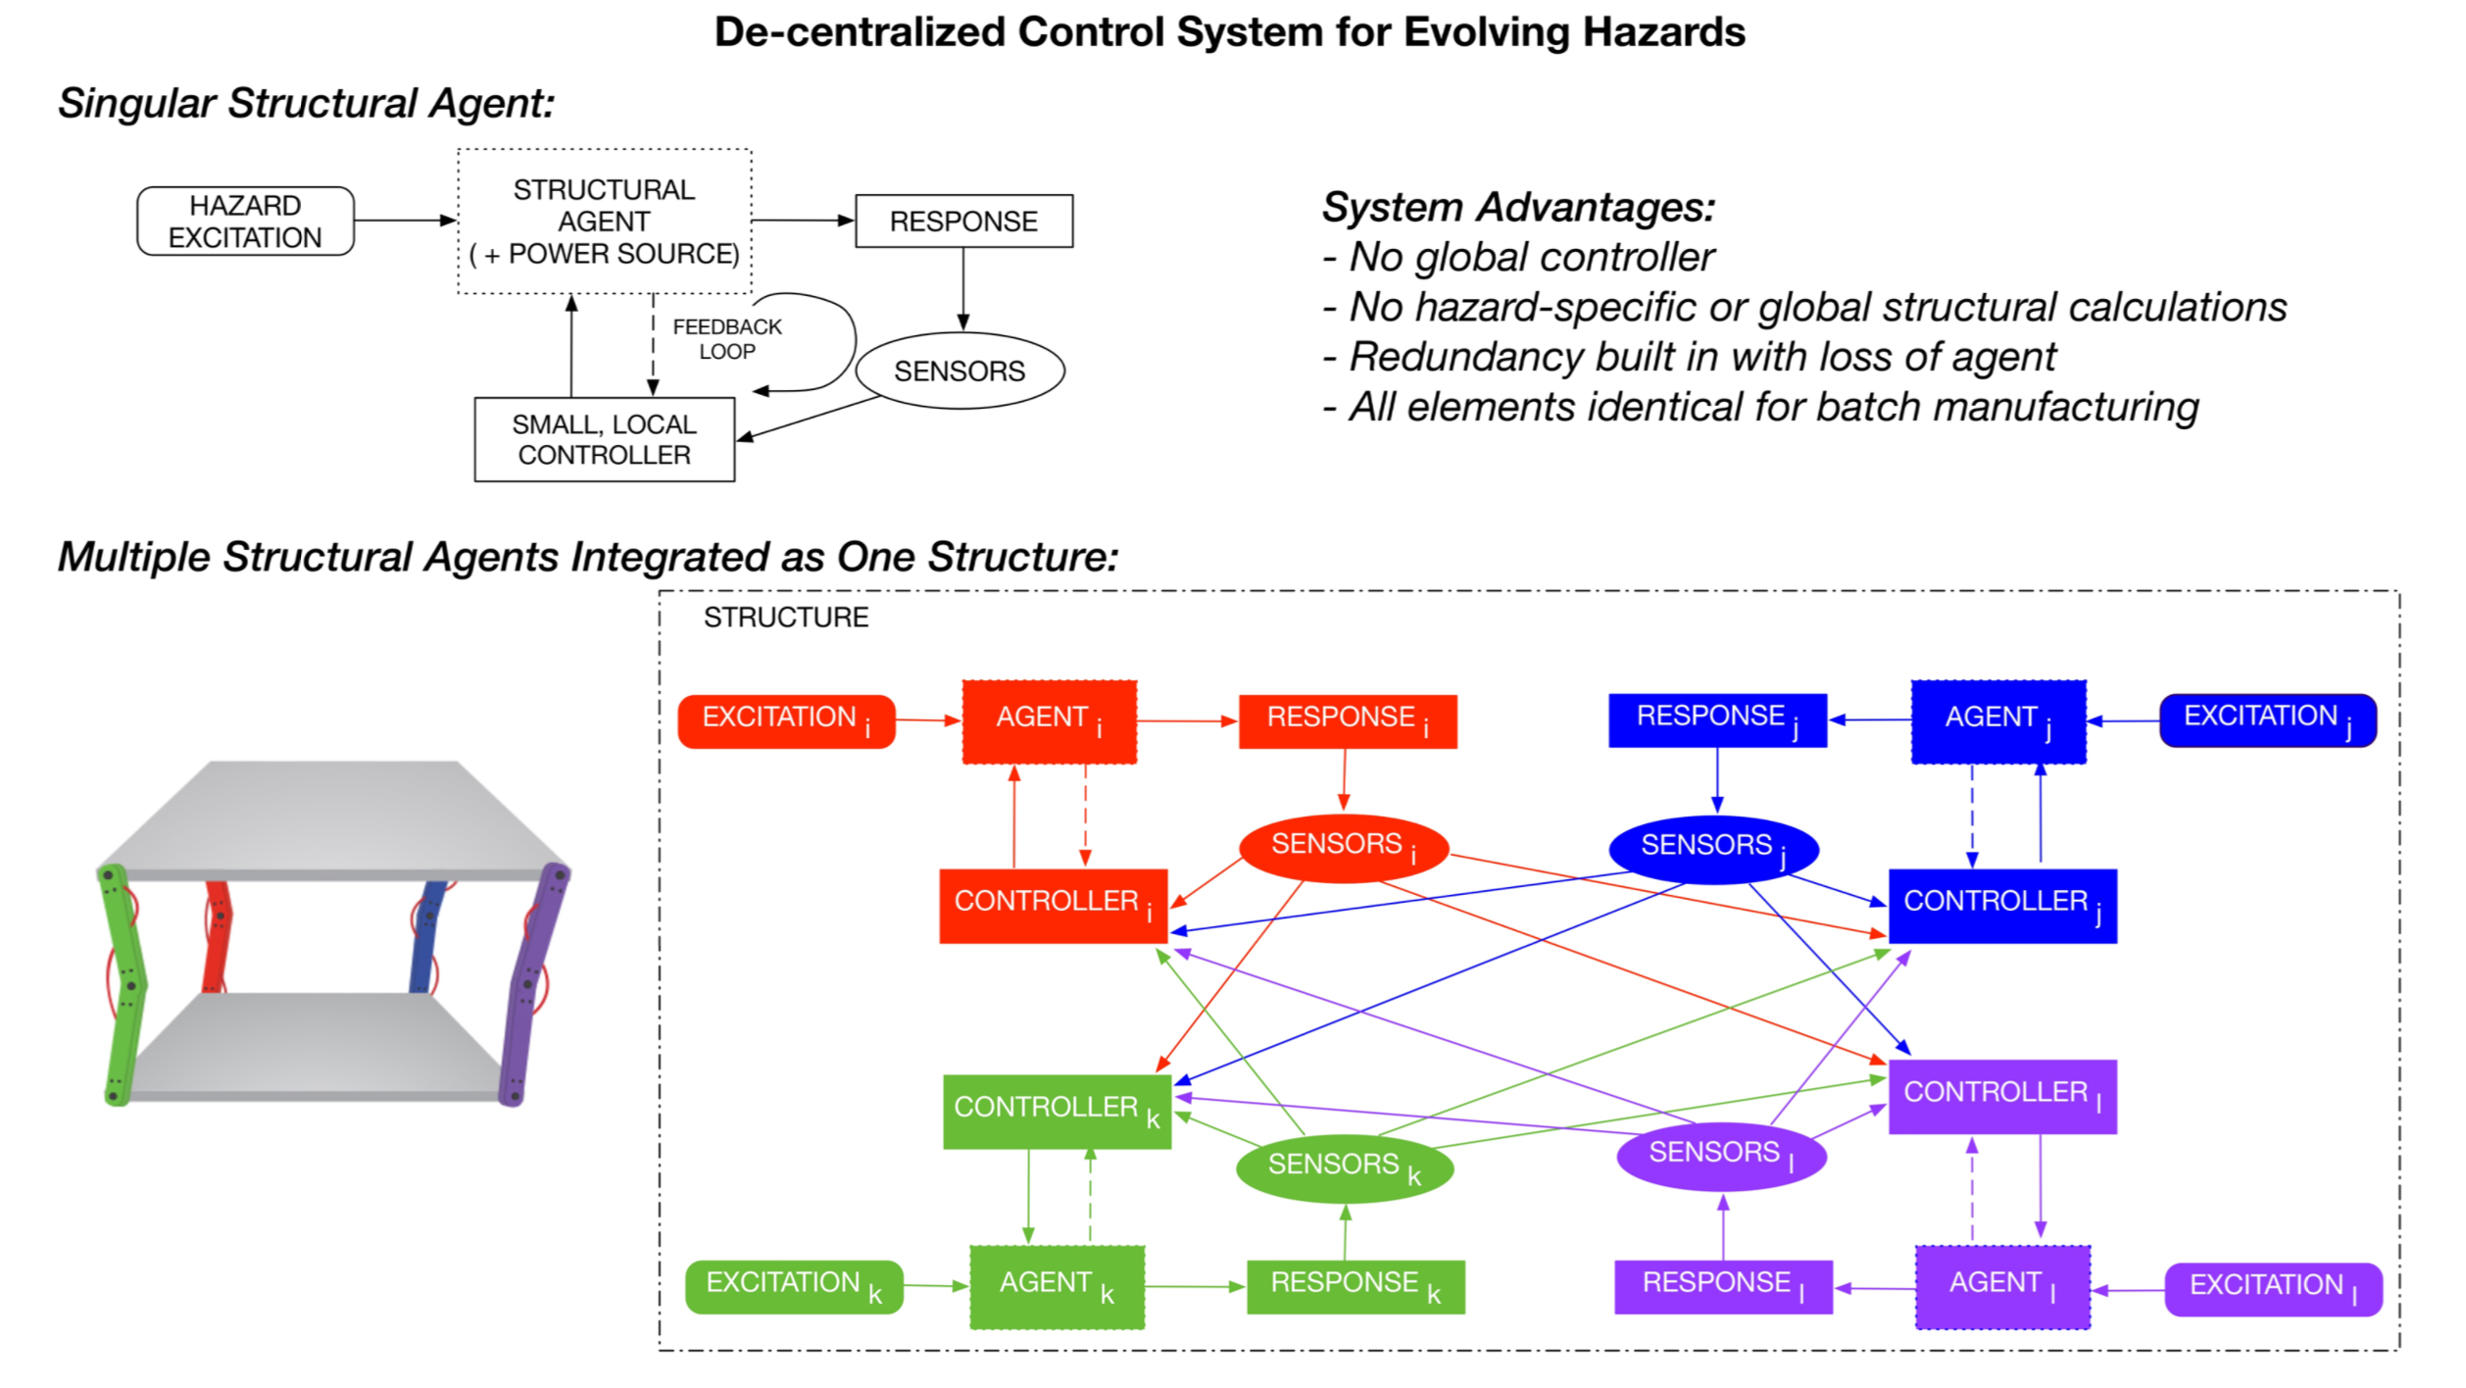
De-centralized Control System

Slide 16
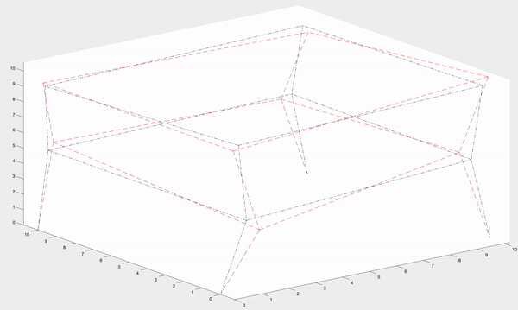
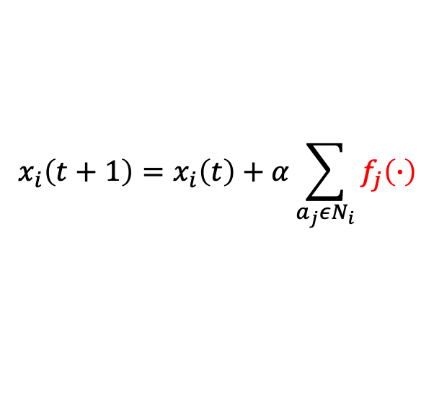
Results (1)
A control framework based on distributed consensus is used to demonstrate this case study building frame maintaining its shape in changing environments.
$$x_{i}\left(t+1\right)=x_{i}\left(t\right)+α\sum_{a_{j}εN_{i}}{f_{j}\left(∙\right)}$$

Slide 17
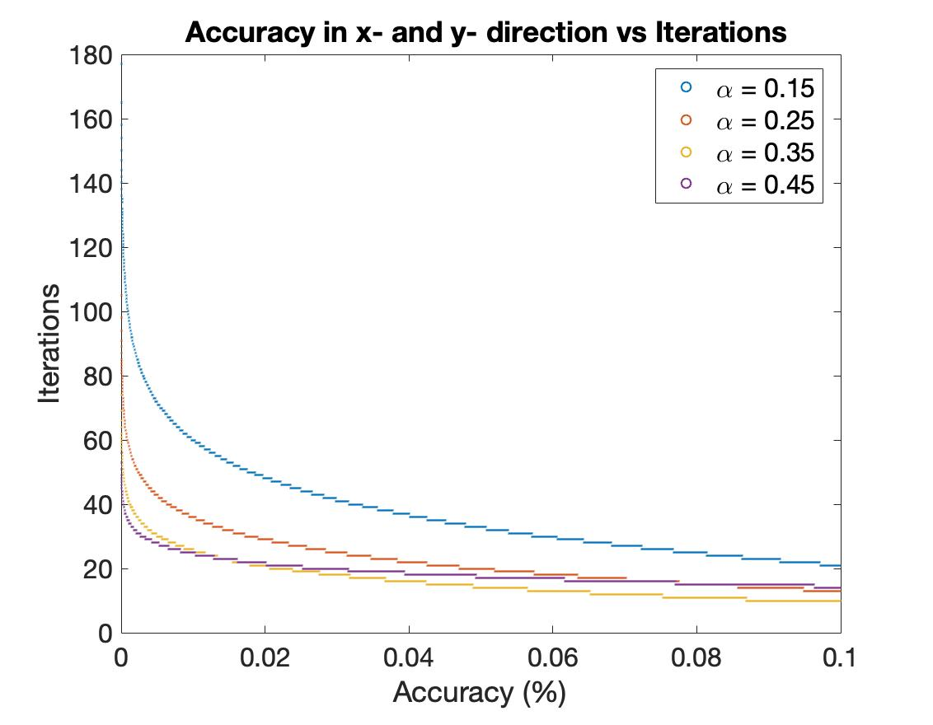
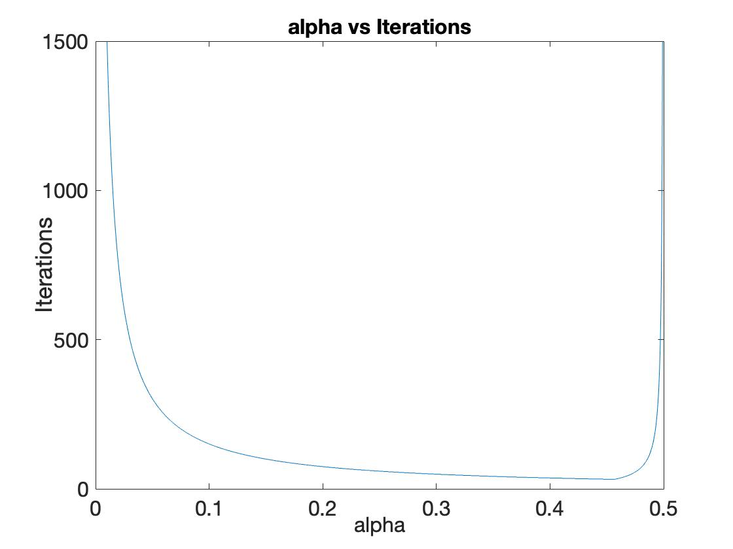
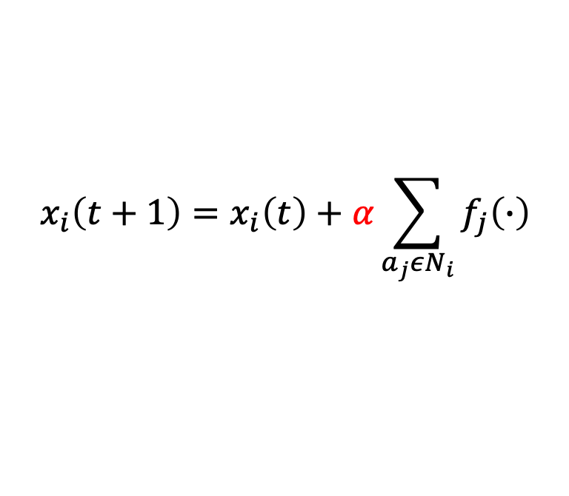
Results (2)
$$x_{i}\left(t+1\right)=x_{i}\left(t\right)+α\sum_{a_{j}εN_{i}}{f_{j}\left(∙\right)}$$

Slide 18
Summary
It is the starting point for integrating de-centralized robotic agents into hazards engineering.
As robots become cheaper, smaller, and more energy efficient, they gain flexibility and finesse, increasing the breadth of potential applications, including hazards engineering.
Because the load definitions become irrelevant, the work has following applications in:
scenarios where the terrain and conditions are unknown, such as deep sea and unknown planetary environments
reconfigurable structures where loading scenarios change constantly.

Slide 19
Future Work
Create prototype robotic structure.
Conduct proof-of-concept experiment with prototype structure.
Test robustness of strategies and agents.
Consider more challenging considerations, such as the agent’s ability to adjust its natural frequency to combat resonance, failure of one or multiple agents (columns), and response to rapidly changing hazard-like environments.
Refine strategies and prototype.

Slide 20
References
[1] S. Kauffman, The Origins of Order: Self Organization and Selection in Evolution. Oxford University Press, 1993.
[2] C. Kube and H. Zhang, “Collective robotics: From social insects to robots,” Adaptive Behavior, vol. 2, no. 2, pp. 189–218, 1993.
[3] S. Camazine, Self-Organization in Biological Systems. Princeton University Press, 2001.
[4] C.-H. Yu and R. Nagpal, “A self-adaptive framework for modular robots in dynamic environment: theory and applications,” The International Journal of Robotics Research, 2010.
[5] A. Preumont, Vibration control of active structures: an introduction, vol. 179. Springer Science & Business Media, 2011.
[6] J. Werfel, K. Petersen, and R. Nagpal, “Designing collective behavior in a termite-inspired robot construction team,” Science, vol. 343, no. 6172, pp. 754–758, 2014.

Slide 21
Thank You Q&A

